Slide 1


Lukas
24.05.2024

Slide 2

Outline
Executive Summary
Introduction
Methodology
Results
Conclusion

Slide 3
Executive Summary
Summary of methodologies
Summary of all results

Slide 4
Introduction
SpaceX Launches
Explore the outcome of launches based on different features
Aim is to find a model that predicts the outcome with high accuracy

Slide 5

Section 1

Slide 6
Methodology
Executive Summary
Data collection methodology:
Data collection using the SpaceX API
Data collection via webscraping
Perform data wrangling
Data cleaning and processing
Perform exploratory data analysis (EDA) using visualization and SQL
Perform interactive visual analytics using Folium and Plotly Dash
Perform predictive analysis using classification models
How to build, tune, evaluate classification models

Slide 7
Data Collection
Describe how data sets were collected.
You need to present your data collection process use key phrases and flowcharts

Slide 8
Data Collection – SpaceX API
Data was collected using the SpaceX API and converted to a pandas DataFrame
Check the notebook here
Simplified worflow
response = requests.get(url)
json.loads(response.content)
pd.json_normalize()

Slide 9
Data Collection - Scraping
Simplified workflow
Data was collected using webscraping from https://en.wikipedia.org/wiki/List_of_Falcon_9_and_Falcon_Heavy_launches
The data is stored in the html file. The BeautifulSoup.find_all() function allows you to find the information.
GitHub URL of the completed web scraping notebook
Request.get
responese=requests.get(url=static_url)
BeautifulSoup()
soup=BeautifulSoup(responese.content,'html.parser')
.find_all
e.g. soup.find_all('table')

Slide 10
Data Wrangling
After obtaining the data we
Check data completeness and data-types
Get an idea about the data by summaring the data using e.g. value_counts()
Create binary column for good and bad landing outcome
Check the notebook here
df.isnull().sum()
df.dtypes
.value_counts()
Df[‘Classs’]

Slide 11
EDA with Data Visualization
As part of the exploratory data analysis we plots
bivariate scatter plots highlighting additionally the class (0: failure, 1: success) by color. We included following variables:
Payload Mass, Flight Number, Launch Site, Orbit
Barplot to check the Success Rate for each Orbit
Line plot to follow the Success Rate against the Year
You can find the notebook here

Slide 12
EDA with SQL
Performed SQL Queries e.g. :
SELECT DISTINCT(Launch_Site) FROM SPACEXTABLE
SELECT * FROM SPACEXTABLE WHERE Launch_Site LIKE 'CCA%' LIMIT 5
SELECT AVG(PAYLOAD_MASS__KG_) FROM SPACEXTABLE WHERE Booster_Version = 'F9 v1.1
select MIN(Date) FROM SPACEXTABLE WHERE Landing_Outcome = 'Success (ground pad)
select DISTINCT(Booster_Version) FROM SPACEXTABLE WHERE Landing_Outcome = 'Success (drone ship)' AND PAYLOAD_MASS__KG_ >4000 AND PAYLOAD_MASS__KG_ <6000
select COUNT(*) FROM SPACEXTABLE WHERE Mission_Outcome Like 'Success%’
select Landing_Outcome, COUNT(*) as count FROM SPACEXTABLE where Date > '2010-06-04' AND Date < '2017-03-20' GROUP BY LANDING_OUTCOME ORDER BY count DESC
You can find the notebook here
Add the GitHub URL of your completed EDA with SQL notebook, as an external reference and peer-review purpose

Slide 13
Build an Interactive Map with Folium
An interactive map helps getting intuitive information on the distinct launching locations and their geographic propterties.
The locations appear as Circles the map
The Circles contain information on how many launches were performed
Zooming in and clicking on the circles visualizes the number of failures and successes
Added distance lines to highlight the distance between the launch site
Railways, highways coastlines and cities
This map gives you an idea about the location and proximity of the launch sites
You can find the notebook here

Slide 14
Build a Dashboard with Plotly Dash
In the Plotly Dashboard
You find a Piechart that shows you the proportions of failure and success for the site that you select
A scatterplot shows to you the relationship between Payload Mass, Booster Version and Success
Like this you can immediately see whether a site is successful or not and which booster version and payload masses tend to predict a good outcome
You can find the Dash App here

Slide 15
Predictive Analysis (Classification)
Split data into train and test sets
4 different models (Logistic Regression, Support Vector Machine, Decision Tree and K Nearest Neighbour)
Cross validation helped finding the best hyperparameters which were used in the final model
The confusion matrix and accuracy score helped finding the best performing model
You can find the notebook here
train_test_split()
set parameters
Determine the model
GridSearchCV
.fit(X_train, Y_train)
acccuracy_score(Y_test, .predict(X_test))

Slide 16
Results
Insights drawn from EDA
Interactive analytics demo in screenshots
Predictive analysis results

Slide 17

Section 2

Slide 18
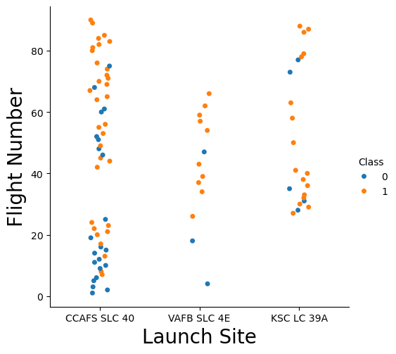
Flight Number vs. Launch Site
Three distinct sites are shown
Most flights early and late were launched in CCAFS SLC 40
Later flight numbers show tend to be more successful

Slide 19
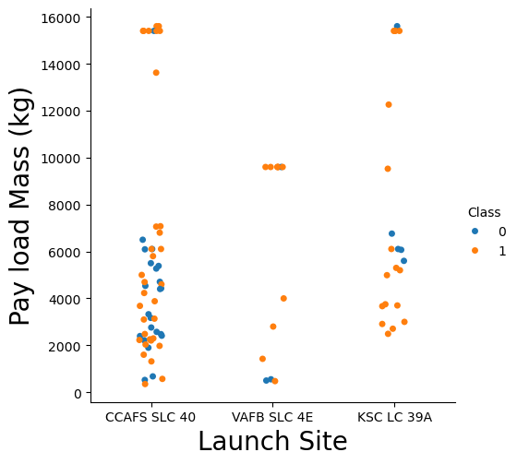
Payload vs. Launch Site
No heavy payloads at launch site VAFB SLC 4E

Slide 20
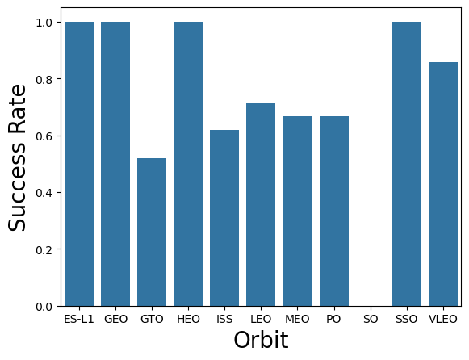
Success Rate vs. Orbit Type
4 Orbit Types with 100% Success rate

Slide 21
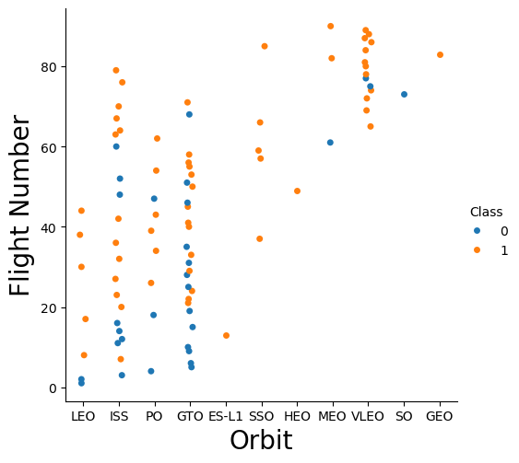
Flight Number vs. Orbit Type
Orbit types with 100% Success rate might be misleading → not many launches
Later, different orbit types were used than at the beginning

Slide 22
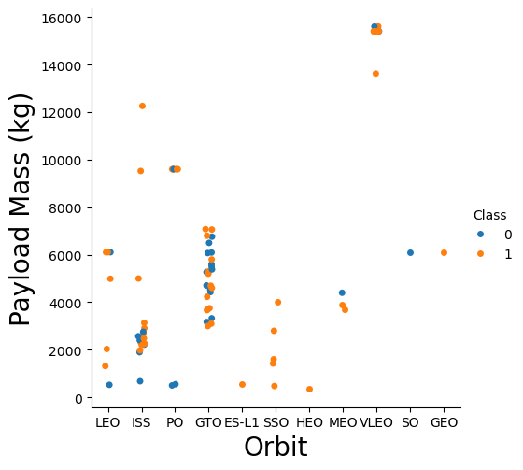
Payload vs. Orbit Type
Not much variation of Payload síze within an Orbit type

Slide 23
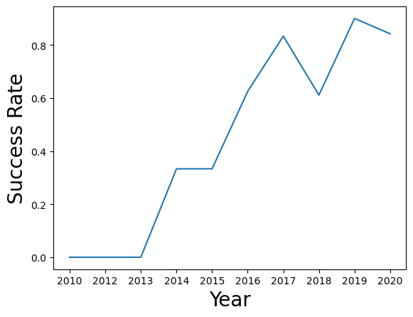
Launch Success Yearly Trend
Clear positive trend of Success rate with increasing year.
Indicates a steep learning from initial failures

Slide 24
All Launch Site Names
%sql select DISTINCT(Launch_Site) from SPACEXTABLE
CCAFS LC-40
VAFB SLC-4E
KSC LC-39A
CCAFS SLC-40

Slide 25
Launch Site Names Begin with 'CCA'
%sql SELECT * FROM SPACEXTABLE WHERE Launch_Site LIKE 'CCA%' LIMIT 5
Date | Time (UTC) | Booster_Version | Launch_Site | Payload | PAYLOAD_MASS__KG_ | Orbit | Customer | Mission_Outcome | Landing_Outcome
2010-06-04 | 18:45:00 | F9 v1.0 B0003 | CCAFS LC-40 | Dragon Spacecraft Qualification Unit | 0 | LEO | SpaceX | Success | Failure (parachute)
2010-12-08 | 15:43:00 | F9 v1.0 B0004 | CCAFS LC-40 | Dragon demo flight C1, two CubeSats, barrel of Brouere cheese | 0 | LEO (ISS) | NASA (COTS) NRO | Success | Failure (parachute)
2012-05-22 | 7:44:00 | F9 v1.0 B0005 | CCAFS LC-40 | Dragon demo flight C2 | 525 | LEO (ISS) | NASA (COTS) | Success | No attempt
2012-10-08 | 0:35:00 | F9 v1.0 B0006 | CCAFS LC-40 | SpaceX CRS-1 | 500 | LEO (ISS) | NASA (CRS) | Success | No attempt
2013-03-01 | 15:10:00 | F9 v1.0 B0007 | CCAFS LC-40 | SpaceX CRS-2 | 677 | LEO (ISS) | NASA (CRS) | Success | No attempt

Slide 26
Total Payload Mass
%sql select SUM(PAYLOAD_MASS__KG_) FROM SPACEXTABLE WHERE Launch_Site = 'NASA (CRS)’
None

Slide 27
Average Payload Mass by F9 v1.1
%sql select AVG(PAYLOAD_MASS__KG_) FROM SPACEXTABLE WHERE Booster_Version = ‘F9
2928.4

Slide 28
First Successful Ground Landing Date
%sql select MIN(Date) FROM SPACEXTABLE WHERE Landing_Outcome = 'Success (ground pad)
2015-12-22

Slide 29
Successful Drone Ship Landing with Payload between 4000 and 6000
%sql select DISTINCT(Booster_Version) FROM SPACEXTABLE WHERE Landing_Outcome = 'Success (drone ship)' AND PAYLOAD_MASS__KG_ >4000 AND PAYLOAD_MASS__KG_ <6000
F9 FT B1022
F9 FT B1026
F9 FT B1021.2
F9 FT B1031.2

Slide 30
Total Number of Successful and Failure Mission Outcomes
%sql select COUNT(*) FROM SPACEXTABLE WHERE Mission_Outcome Like 'Success%’
100

Slide 31
F9 B5 B1048.4
F9 B5 B1049.4
F9 B5 B1051.3
F9 B5 B1056.4
F9 B5 B1048.5
F9 B5 B1051.4
F9 B5 B1049.5
F9 B5 B1060.2
F9 B5 B1058.3
F9 B5 B1051.6
F9 B5 B1060.3
F9 B5 B1049.7
Boosters Carried Maximum Payload
%sql select DISTINCT(Booster_Version) FROM SPACEXTABLE WHERE PAYLOAD_MASS__KG_ = (select MAX(PAYLOAD_MASS__KG_) FROM SPACEXTABLE)

Slide 32
2015 Launch Records
%sql select SUBSTR(Date, 6,2) as Month, Landing_Outcome, Booster_Version, launch_site from SPACEXTABLE WHERE Landing_Outcome = 'Failure (drone ship)' AND SUBSTR(Date, 0,5)
Month | Landing_Outcome | Booster_Version | Launch_Site
01 | Failure (drone ship) | F9 v1.1 B1012 | CCAFS LC-40
04 | Failure (drone ship) | F9 v1.1 B1015 | CCAFS LC-40
01 | Failure (drone ship) | F9 v1.1 B1017 | VAFB SLC-4E
03 | Failure (drone ship) | F9 FT B1020 | CCAFS LC-40
06 | Failure (drone ship) | F9 FT B1024 | CCAFS LC-40

Slide 33
Rank Landing Outcomes Between 2010-06-04 and 2017-03-20
%sql select Landing_Outcome, COUNT(*) as count FROM SPACEXTABLE where Date > '2010-06-04' AND Date < '2017-03-20' GROUP BY LANDING_OUTCOME ORDER BY count DESC
Landing_Outcome | count
No attempt | 10
Success (drone ship) | 5
Failure (drone ship) | 5
Success (ground pad) | 3
Controlled (ocean) | 3
Uncontrolled (ocean) | 2
Precluded (drone ship) | 1
Failure (parachute) | 1

Slide 34

Section 3

Slide 35
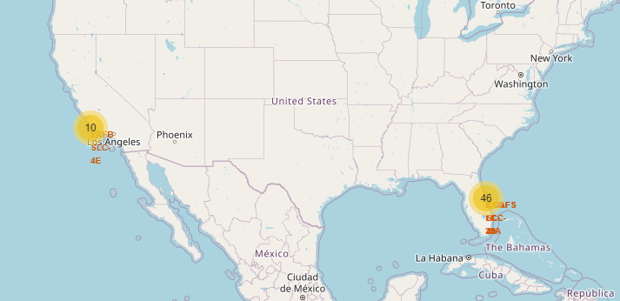
Geographic Distribution of SpaceX launches
The yellow circles indicate the launch site locations with the respective number of launch attempts

Slide 36
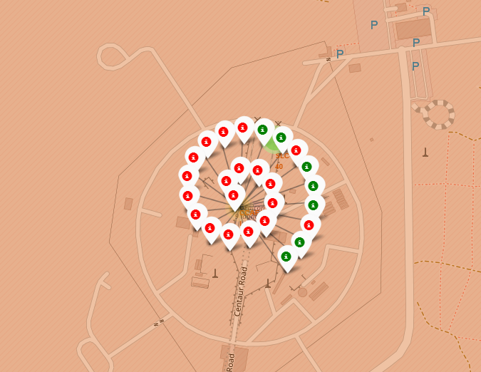
Success and Failure for CCAFS LC-40
Each label indicates one launch
The color indicates success (green) or failure (red)

Slide 37
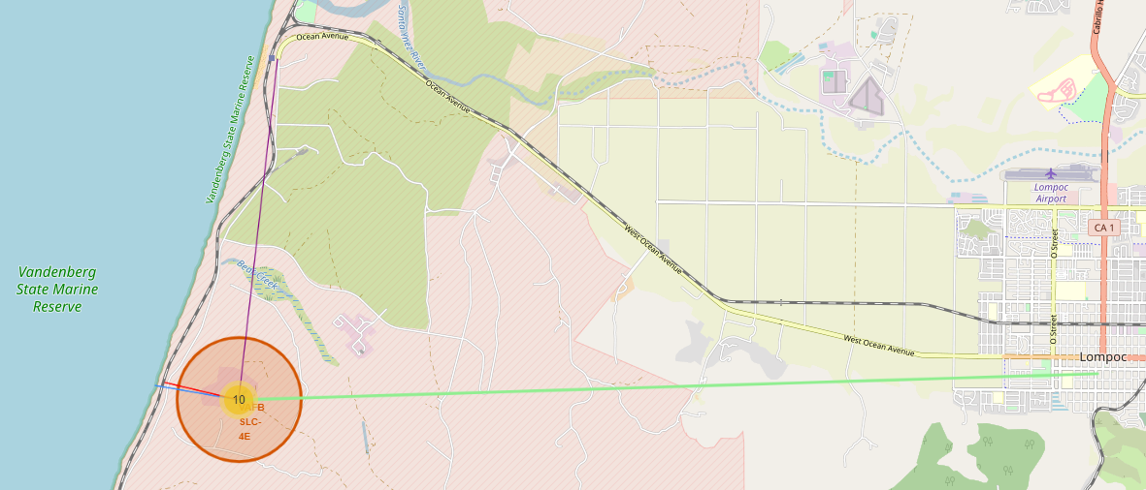
VAFB SLC-4E Launch Site Proximities
Lines indicate distances to the nearest coast (blue), railway (red), highways (purple) and city (light green)

Slide 38

Section 4

Slide 39
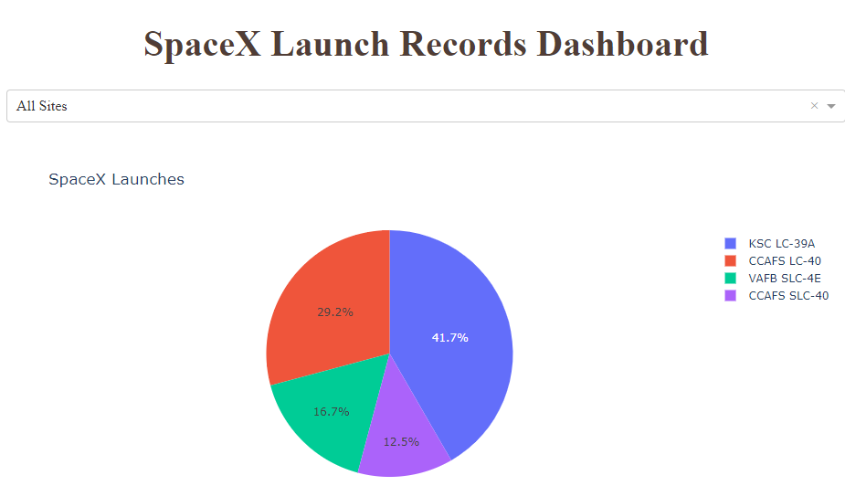
Proportion of Successful attempts grouped by Launch Site

Slide 40
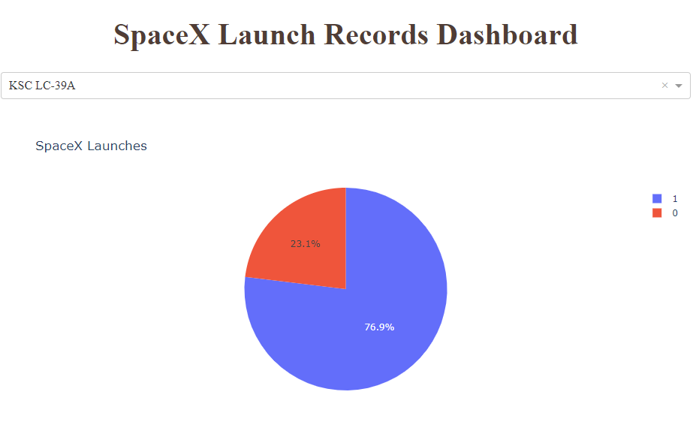
Outcome proportion of most successful Site
Red indicates Failure, Blue Success

Slide 41
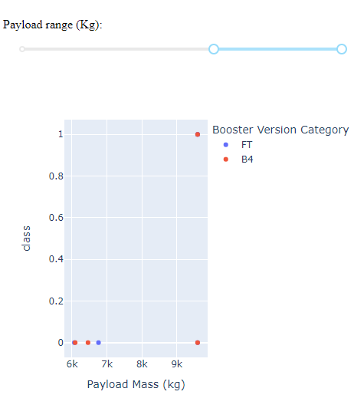
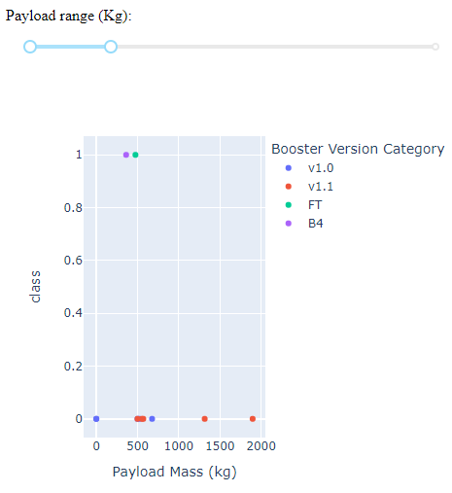
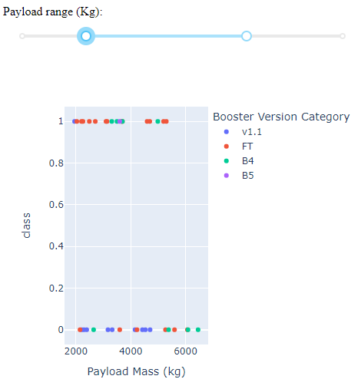
Outcome of Payload Mass and Booster Versions
Please notice the slider that adjusts the limits of Payload Mass
Most Flights were performed with intermediate Payload Mass

Slide 42

Section 5

Slide 43
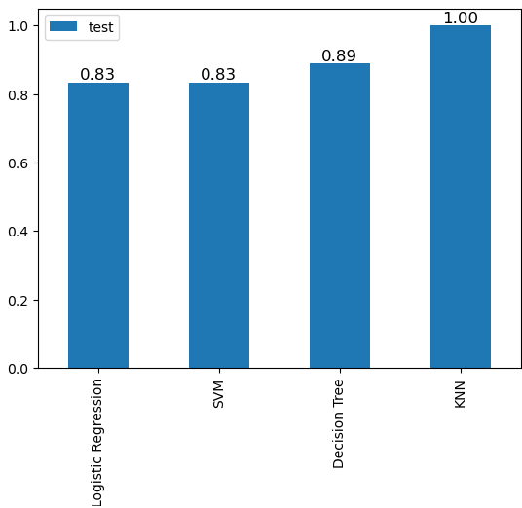
Classification Accuracy
The plot shows the accuracy (y-axis) of the different models (x-axis)
K Nearest Neighbour shows the best accuracy compared to the other models.

Slide 44
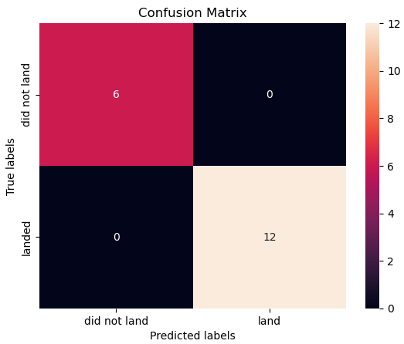
Confusion Matrix
The confusion matrix shows the number of correct and incorrect classifications of the test data
The confusion matrix shows that the model predicted all outcomes correctly.

Slide 45
Conclusions
General
Launch Sites are near costs, in the proximity of railways and highways but away from bigger cities
This allows efficient transport of material while maintaining safety for the people in case of unsuccessful attempts
SpaceX learns from experience
With time the success rate increases
Possible reasons for improvement
Changed Orbit Types with later Launches
Use higher pay load
Use successful pay loads more often

Slide 46


